Slide 1
Anti-Discrimination Working Group
Meeting #2
Wednesday, 17 May 2023
10.00, NCRR main meeting room (and online)

Slide 2

Agenda
Introduction round
Aims of the group
Adam Rutherford’s podcast: History of eugenics
Legacy of eugenics in (psychiatric) genetics
Discussion: Are we already living in the Brave New World?
Ideas for next meeting

Slide 3
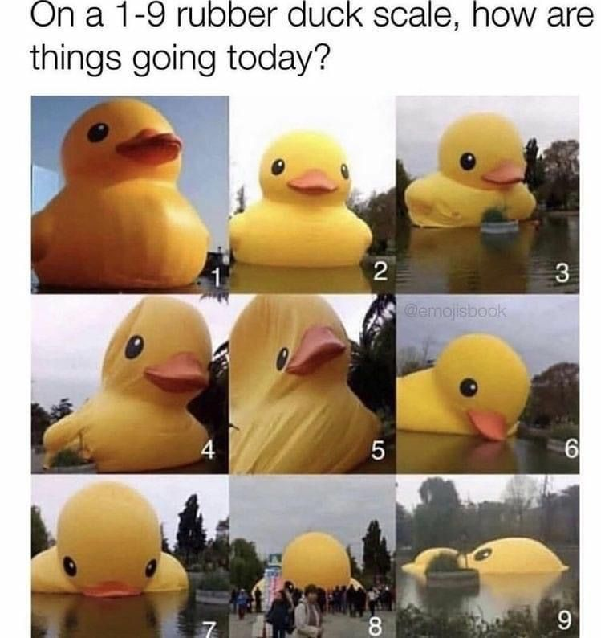
Introductions

Slide 4
Aims of the group
To strive for equality
To strive for diversity
To be open & transparent
To be mindful that the topics we discuss may be triggering and upsetting, impacting on people in different ways.
This is not a passive intellectual topic. It takes time to install the correct support and find solutions. This is a learning process.
To discuss ongoing issues with discrimination in research
To recognize harmful structures and practices of discrimination in research
To advocate for changes that promote equity in research

Slide 5
Eugenics
the practice or advocacy of controlled selective breeding of human populations (as by sterilization) to improve the population's genetic composition Merriam-Webster dictionary

Slide 6


Adam Rutherford’s Podcast
Notes:
British geneticist
PhD in genetics at the University College London
Book author and speaker on many podcasts: Passionate about popular science
Books:
Control: The The Dark History and Troubling Present of Eugenics
How to Argue with a Racist (https://www.adamrutherford.com/race)

Slide 7

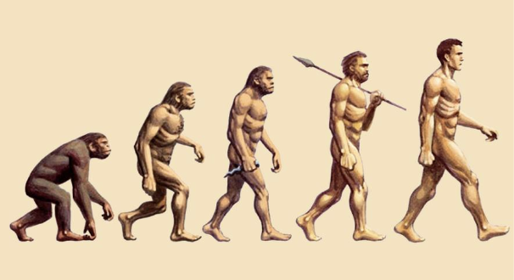


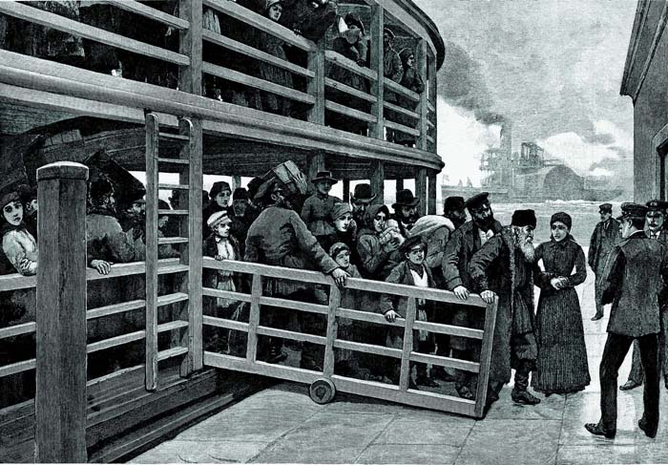
Eugenics forms as an ideology
Ancient idea: Population control
Plato’s utopian city-state
Infanticide (e.g., Sparta)
Origin of Species (1859) by Charles Darwin
Experiments on Plant Hybridization (1866) by Gregor Mendel
Hereditary Genius (1869) by Francis Galton
Distribution: ”great men”—”degenerates”
Notes:
Plato’s utopian city-state: marriage of individuals of same “quality”
Francis Galton (1822–1911)
Forensic fingerprinting, statistical methods (bivariate normal distribution as related to population stability), eugenics
Context: Victorian era, industrialization, immigration, veneration of classical civilizations and ”declinism”, alcoholism and sex work seen as huge societal problems
Declinism = everything was better then, everything is worse know

Slide 8

Eugenics is put into policy and practice
Eugenics Record Office (1910–1939) by Charles Davenport
Cold Spring Harbor Laboratory, New York, USA
H. H. Laughlin writes eugenics law template
International Conference on Eugenics (1912–1932), journals, etc.
30+ countries passed eugenics legislation in the 20th century
Political figures: Teddy Roosevelt, Churchill, Hitler, Mussolini, and so on…
Notes:
Beginning in 1907, individual states in USA beginning with Indiana pass sterilization laws (70,000-80,000 individuals affected in 20th century)
Cold Spring Harbor Laboratory later led by Watson (1968-2007) of Watson & Crick (double helix structure of DNA)
Davenport and Laughlin influence 1924 Immigration Act
UK: 1912: Mental Deficiency Act proposed by Churchill, would have included enforced sterilization, but never passed
Racism, patriotism, and eugenics allied as a reflection of the social agenda of the day
Kaiser Wilhelm Institute for Anthropology, Human Heredity, and Eugenics in Berlin founded in 1927, sponsored by the Rockefeller Foundation
Eugenics ultimately failed as a science in the 1930s and ’40s, when the assumptions of eugenicists became heavily criticized and the Nazis used eugenics to support the extermination of entire races.

Slide 9





Eugenics in Denmark
1923: “Mentally retarded” and seriously mentally ill ______need permission to marry
1929: First sterilization law passed
1934: Mentally Handicapped Act (revised 1935)
1923–1961: Girl’s Home on Sprogø
1934–1967: Mentally Handicapped Act leads to tens ___________of thousands of sterilizations
1966–1974: IUD campaign in Greenland
Christian Keller and the Social Democrats
Notes:
1923 marriage law
“mentally retarded” and seriously mentally ill need permission to marry
First of many marriage laws
1929 sterilization law
Denmark first European state to pass racial hygeine national legislation
Castration of males, sterilization of females
Sterilization because “too active and too normal to be kept under strict supervision in a closed section of an institution”
Girl’s Home on Sprogø / Kellersk Institut (1923-1961)
500 ”sexually loose” and “mentally ill” Danish women exiled to island, forced to work
Could only leave if they were sterilized
Mentally Handicapped Act (1934-1967)
Leads to a total of 11,000 castrations and sterilizations
Some distinction between mentally ”normal” and ”abnormal” (too normal → eugenic criterion)
“all applications for sterilization had to be accompanied by— among other relevant information—an estimate of the hereditary disposition” –thesis from Helsinki
“schizophrenics and certain cases of epilepsy as well as a number of well-defined hereditary neurological diseases, including Huntington's chorea, should provide indications for sterilization”
Alcoholics,
The IUD Campaign in Greenland (1966-1974)
About 4,500 women given IUDs (about half of women in Greenland at the time?)
IUDs without consent, supposedly to support the economic development of Greenland, where falling mortality rates and high fertility rates were driving a population boom
Some very young → complications and fertility problems
Greenlandic MP in Denmark Aki-Matilda Høegh-Dam said to the Greenlandic news website sermitsiaq. AG. She argues that the IUD campaign falls under the UN definition of genocide for the crime of “imposing measures intended to prevent births within the group”.
Parallels to:
Forced sterilization of Native American women in USA even recently
Aggressive “family planning” campaigns in indigenous tribes in Malaysia since the 1980s

Slide 10
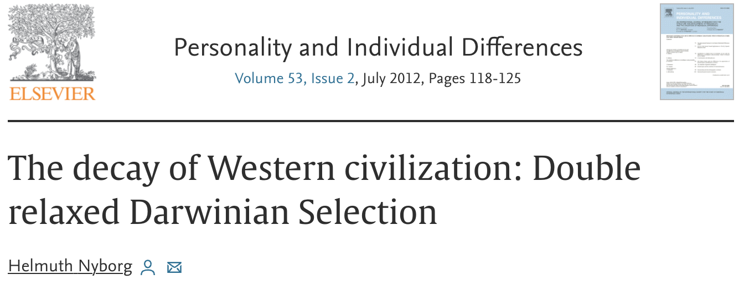
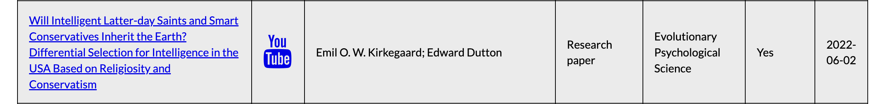
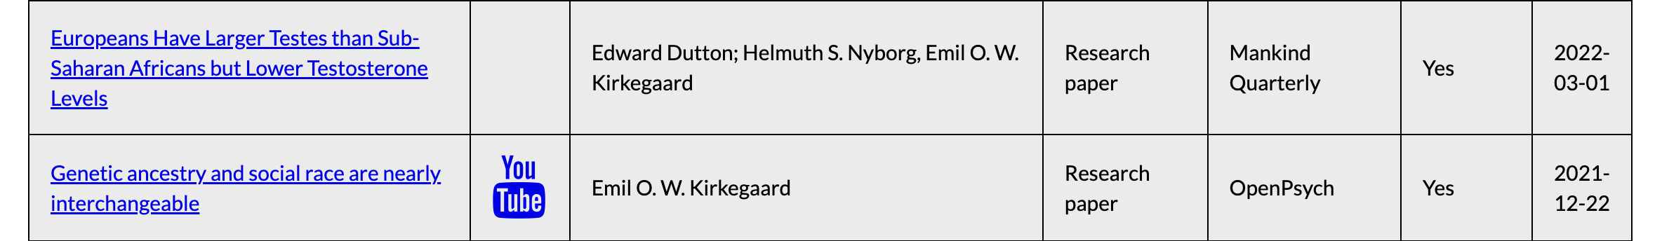


Eugenics in Denmark
Notes:
Helmuth Nyborg
Professor emeritus of Developmental and Child Psychology, Institute of Psychology, Aarhus university (retired 2007)
Paper: argued that migration from third world countries to Denmark would cause a dysgenic effect on the country's average IQ over time
Also another paper reinforcing black-white differences in IQ
Came under investigation for scientific misconduct for papers, but eventually won case
Has also written many articles for “Mankind Quarterly”
Emil Kirkegaard
Multiple papers and YouTube channel promoting discriminatory views with genetics ”research”
Co-founder of multiple journals that sound like “open access” or legitimate journals, but publish pro-discriminatory research
Active member of London Conference on Intelligence (2014-2017 UCL; 2018 Skanderborg; now?)

Slide 11
Legacy of eugenics in (psychiatric) genetics
The study of human inheritance is the foundation of human genetics
Then: For “the betterment of human society”
Now: For pure science and development of treatment for medical conditions
“Galton Laboratory” at University College London today
Emil Kraepelin (1856–1926)
Founder of modern scientific psychiatry, psychopharmacology and psychiatric genetics
Eugenic views → Diagnostic classification system (DSM, ICD)
Notes:
Physical legacy:
Some eugenics institutes are now human genetics research institutes
MPI brain tissue samples
Emil Kraepelin
Eugenicist and antisemite (concerned about degeneration of the gene pool, likened lower SES with Zusammenpferchung of animals)
Self-domestication theory (welfare state and public education → less weak people being weeded out; a form of social Darwinism)
"the number of idiots, epileptics, psychopaths, criminals, prostitutes, and tramps who descend from alcoholic and syphilitic parents, and who transfer their inferiority to their offspring, is incalculable”
Founder of the German Institute for Psychiatric Research (DFA) in Munich → Max Planck Institute of Psychiatry

Slide 12





Are we already living in the Brave New World?
Notes:
Are we already living in the Brave New World?
Adam Rutherford: Agricultural analogy does not work
Selective breeding inefficient (Big, milky udders; But also susceptibility to diseases, mastitis, lameness)
Culling
Bred for specific, not general improvement
Brave New World (1932)
World State
Citizens are engineered through artificial wombs and childhood indoctrination programmes into predetermined classes (or castes; Alpha-Plus, Alpha, Beta, Beta-Minus, Savages on the Reservation) based on intelligence and labour
The Handmaid’s Tale (book: 1985; TV series: 2017)
Totalitarian state Gilead; plummeting fertility rates and environmental disaster as justification
”all remaining fertile women need to be collected and impregnated by those of superior status”
Blade Runner (film: 1982)
Bio-engineered “replicants” better in strength, intelligence, beauty but practically enslaves
“Specials” are deemed ”biologically unacceptable, a menace to the pristine heredity of the human race”
History: Genentech founded in the 1970s
Gattaca (1997)
Genetic determinism
parents choose for their offspring the traits that are favored by society, “in-valids” (not gene-edited) face discrimination
Idiocracy (2006)
Sinking average IQ over generations due to “natural selection” / “higher rates of breeding among those with lower IQ”

Slide 13
Are we already living in the Brave New World?
Fertility control with/out consent
Genetic screening and counseling for couples
e.g., hemophilia, Tay Sachs
Prenatal screening and termination of pregnancies
Gene editing
Treatment of adults suffering from hereditary disorders
Notes:
How to practice active anti-discrimination as a researcher and a member of society with regard to this points?
Intersection with religion/culture…
People who discriminate will always turn to scientists to validate their ideas
Adam Rutherford: “Techniques for personal and parental autonomy rather than state-imposed control of societies”
Adam Rutherford: Even though we know much more about genetics now, we still do not know enough about heredity
Any experience with 23andMe?

Slide 14
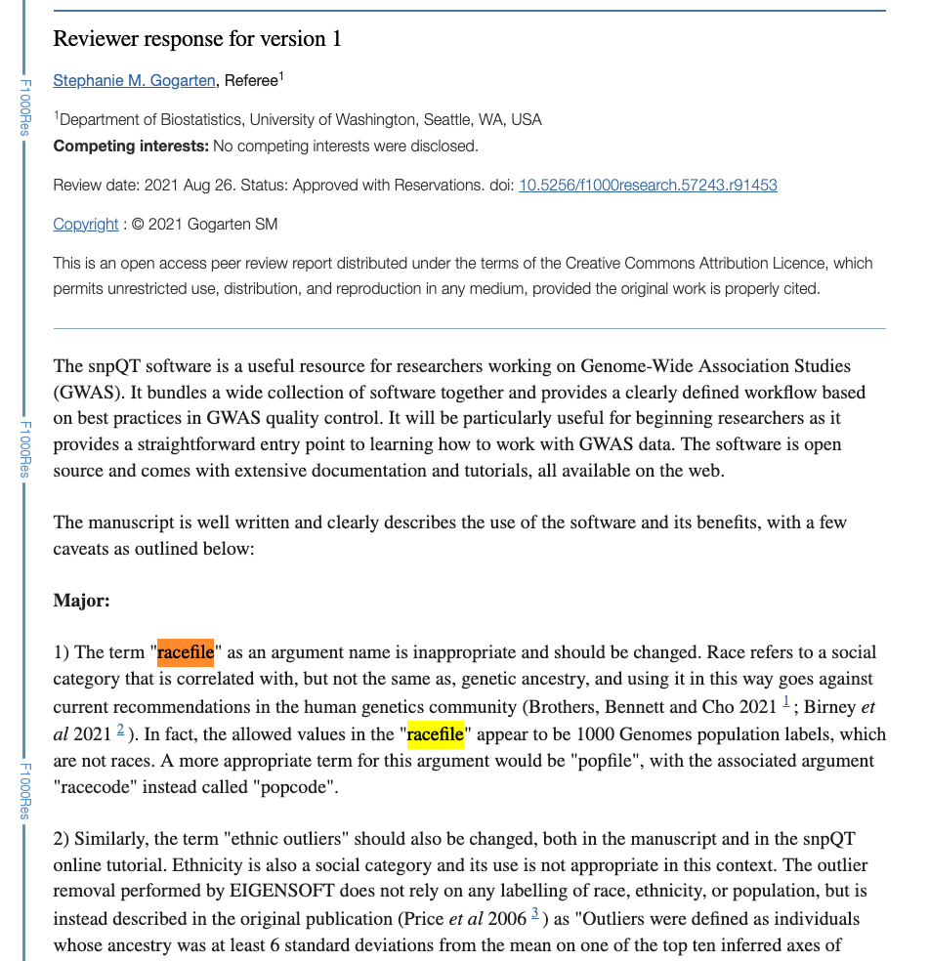
Ideas for next meeting
Historical perspective
E.g., parallel development of genetics and eugenics
Book club
E.g., The Immortal Life of Henrietta Lacks
How-to: Active anti-discrimination
E.g., “racefile” for PC plots in a published bioinformatics tool → here is how one reviewer addressed it:

Slide 15



Thanks!
Next meeting:
June ?
Jess Mundy
Hannah Chatwin
Alisha Hall
Jette Steinbach
jmundy@clin.au.dk
hchatwin.ncrr@au.dk
alishasmhall@clin.au.dk
jst.ncrr@au.dk
@jessmndy
@hannahchatwin2
@asmhall
_

Slide 16
Resources / Further information
Bad Blood: The Story of Eugenics (BBC Radio 4 extended podcast by Adam Rutherford)
https://danskracismeforskning.dk/
Pigehjemmet på Sprogø / Kellersk Institut (English article)
Danish podcast Spiralkampagnen (DR “The IUD Campaign” in Greenland; + English article summarizing it)
Has the "London Conference on Intelligence” moved to Denmark?

Slide 17
Resources / Further information
Kemp, T. Danish experiences in negative eugenics, 1929-45. Eugen Rev. 1947 Jan;38(4):181-6. PMID: 20286619; PMCID: PMC2986383.
Eugenics and the welfare state, Norway, Sweden, Denmark, and Finland by Gunnar Broberg and Nils Roll-Hansen
Roelcke V. Eugenic concerns, scientific practices: international relations in the establishment of psychiatric genetics in Germany, Britain, the USA and Scandinavia, c.1910-60. Hist Psychiatry. 2019 Mar;30(1):19-37. doi: 10.1177/0957154X18808666. Epub 2018 Nov 1. PMID: 30382757.

